Slide 1

One: Please dare to believe for many descendants
Genesis 13:14-16 – “The LORD said to Abram after Lot had
parted from him, ‘Lift up your eyes from where you are and
look north and south, east and west. All the land that you
see I will give to you and your offspring for ever. I will
make your offspring like the dust of the earth, so that
if anyone could count the dust, then your offspring could
be counted.”

Slide 2
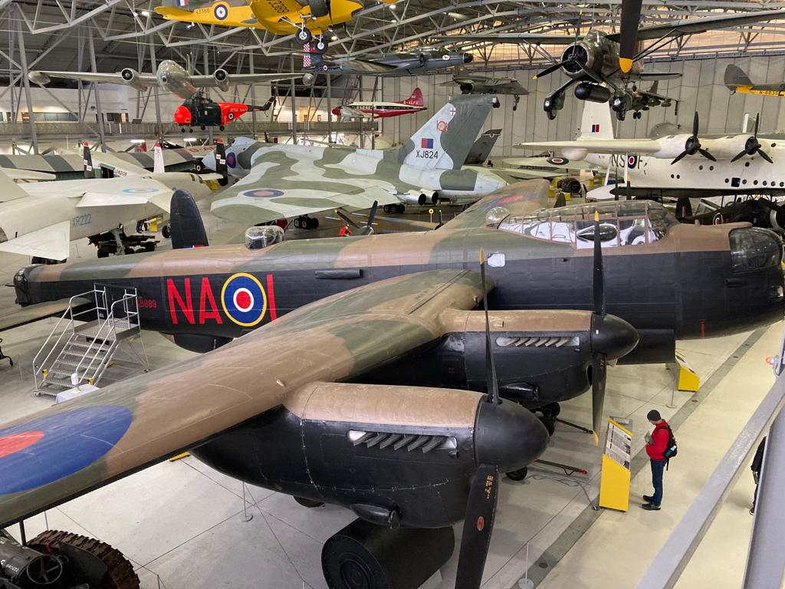
“Please Dare to Believe”
Three lessons in faith from
the life of Abraham

Slide 3
Israel’s story Passover to Promised Land | How Paul presents the gospel in Romans chapters 1-8
Egyptians & Israelites deserving of judgment | Chapters 1-2 – Jews & Gentiles all deserving of judgment
Israelites spared judgment by a sacrificial lamb | Ch. 3 - we are spared judgment by the death of Jesus
Israel through Red Sea = slavery to freedom | Ch. 6 - we through waters of baptism = slavery to freedom
The provision of water & food in the wilderness journey | Ch. 8 - we are given the Holy Spirit to strengthen us
Israel comes into the Promised Land | Ch. 8 – we will live in the New Creation

Slide 4
Paul, a servant of Christ Jesus, called to be an apostle, set apart for the gospel of God, ² which he promised beforehand through his prophets in the holy Scriptures, ³ concerning his Son, who was descended from David according to the flesh ⁴ and was declared to be the Son of God in power according to the Spirit of holiness by his resurrection from the dead, Jesus Christ our Lord, ⁵ through whom we have received grace and apostleship to bring about the obedience of faith for the sake of his name among all the nations, ⁶ including you who are called to belong to Jesus Christ.
Proclamation
Prophecy
Proof
Power

Slide 5
The gospel is a proclamation
The gospel is according to fulfilled prophecy
[Isaiah 53]
The gospel is based on resounding proof
[1 Corinthians 15:1-8]
The gospel is a present power to transform lives

